Slide 1
CSE514 – Datamining Fall 2022 Backpropagation
Cynthia Ma
Department of Computer Science
Washington University in St. Louis
czma@wustl.edu

Slide 2
Quick admin follow-up
Homework 1 regrade requests close tomorrow
Alphabetical ordering does not make a categorical data type “ordinal”
Lecture recording links expire in a week

Slide 3
kNN Classification Algorithm
Define a distance (or similarity) metric
Define k (an integer greater than zero)
Calculate the distances between the test sample and all training samples
Select the k training samples with the shortest distances
Get the labels of the k selected samples
Regression: return the mean as the prediction
Classification: return the mode as the prediction

Slide 4
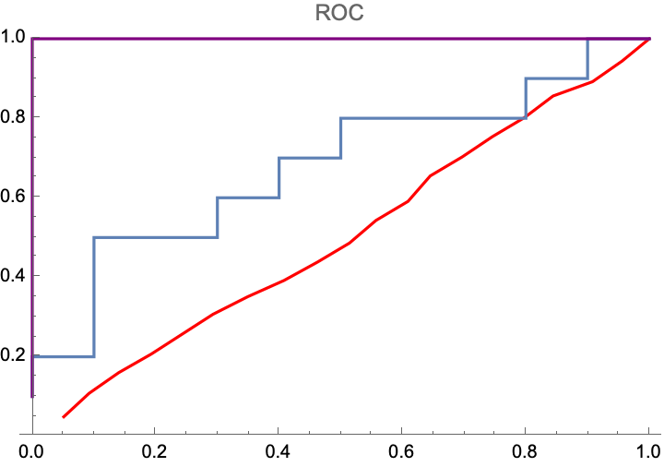
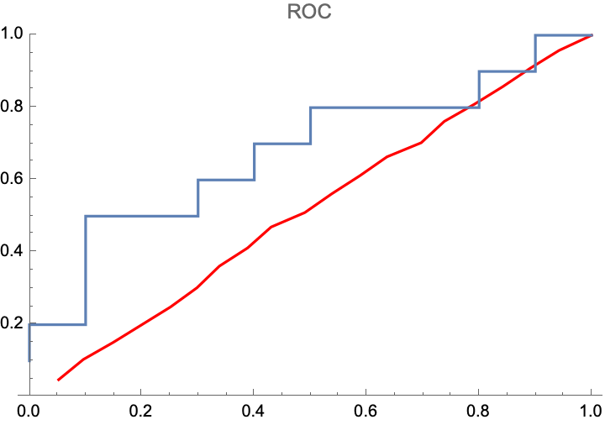
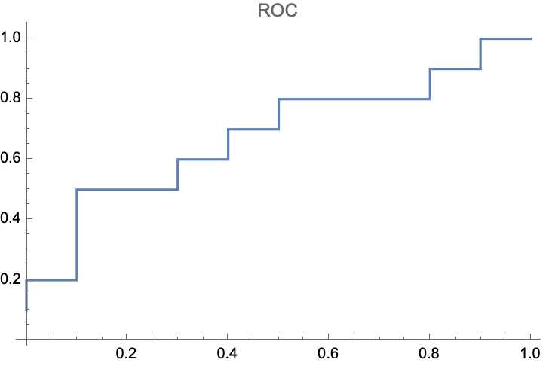
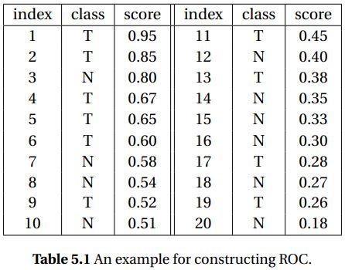
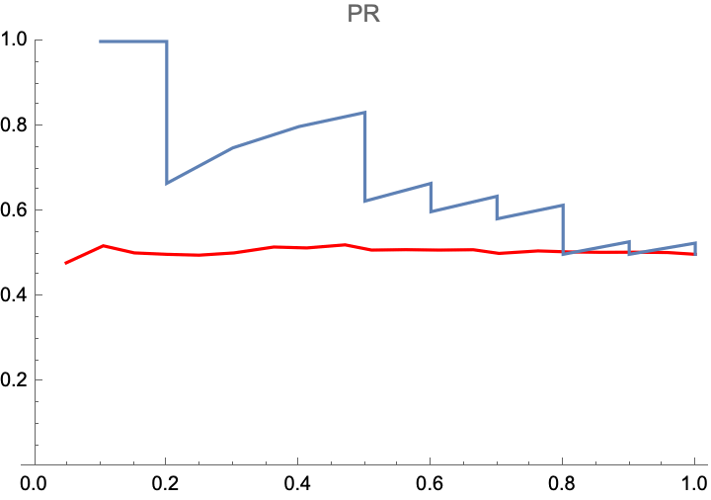
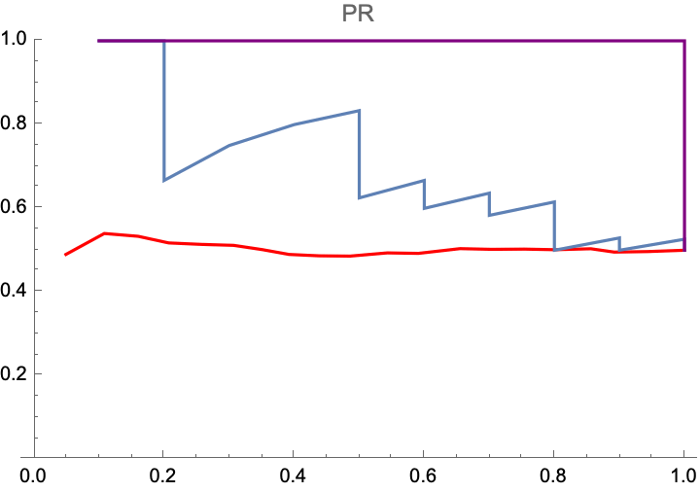
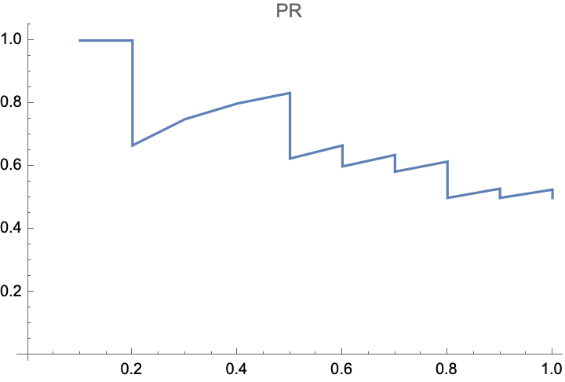
ROC and PR curve example

Slide 5
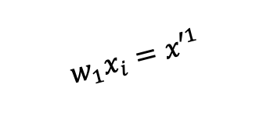
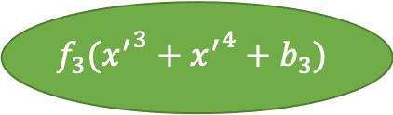
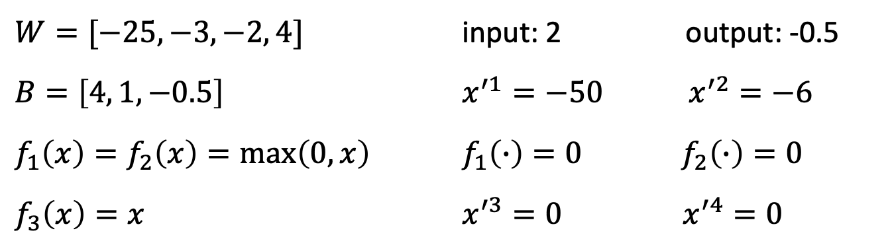
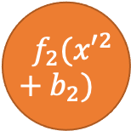
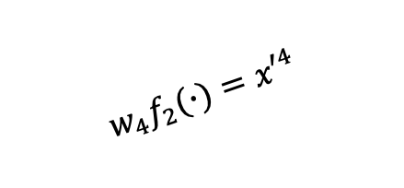

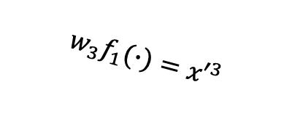
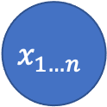
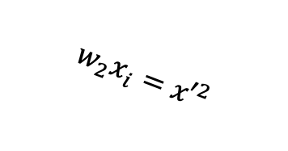
Our simple ANN (input: 2)
$${ f}_{1}({x′}^{1}+b_{1})$$
$$w_{1}x_{i}={x′}^{1}$$
$$w_{3}f_{1}(∙)={x′}^{3}$$
$$x_{1…n}$$
$$f_{3}({x^{′}}^{3}+{x^{′}}^{4}+b_{3})$$
$$w_{2}x_{i}={x′}^{2}$$
$${ f}_{2}({x′}^{2}+b_{2})$$
$$w_{4}f_{2}(∙)={x′}^{4}$$
$W=[−25, −3, −2, 4]$ input: 2 output: -0.5
$B=\left[4, 1, −0.5\right]$ $x^{′1}=−50 x^{′2}=−6$
$f_{1}\left(x\right)=f_{2}\left(x\right)=\max\left(0,x\right)$ $f_{1}\left(∙\right)=0 f_{2}\left(∙\right)=0$
$f_{3}\left(x\right)=x$ $x^{′3}=0 x^{′4}=0$

Slide 6
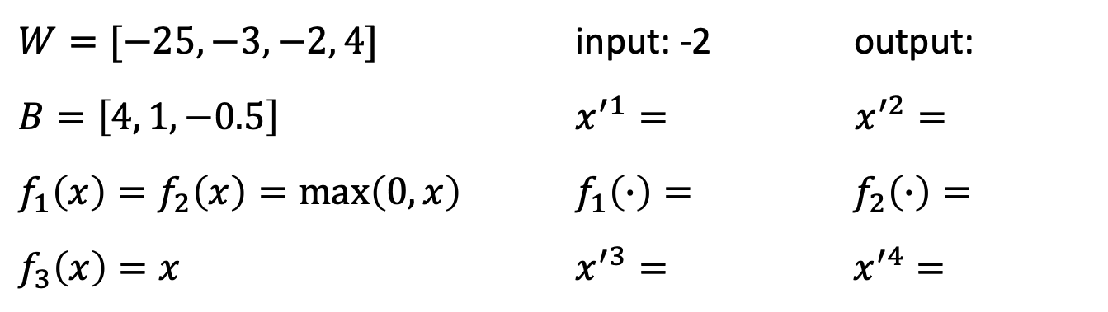
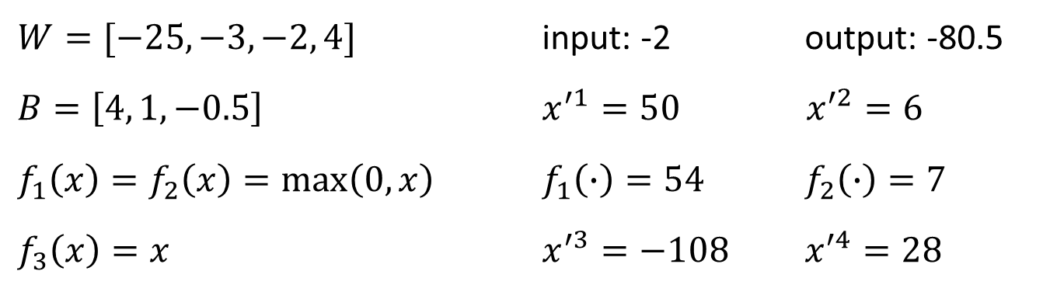
Our simple ANN (input: -2)
$${ f}_{1}({x′}^{1}+b_{1})$$
$$w_{1}x_{i}={x′}^{1}$$
$$w_{3}f_{1}(∙)={x′}^{3}$$
$$x_{1…n}$$
$$f_{3}({x^{′}}^{3}+{x^{′}}^{4}+b_{3})$$
$$w_{2}x_{i}={x′}^{2}$$
$${ f}_{2}({x′}^{2}+b_{2})$$
$$w_{4}f_{2}(∙)={x′}^{4}$$
$W=[−25, −3, −2, 4]$ input: -2 output: -80.5
$B=\left[4, 1, −0.5\right]$ $x^{′1}=50 x^{′2}=6$
$f_{1}\left(x\right)=f_{2}\left(x\right)=\max\left(0,x\right)$ $f_{1}\left(∙\right)=54 f_{2}\left(∙\right)=7$
$f_{3}\left(x\right)=x$ $x^{′3}=−108 x^{′4}=28$
$W=[−25, −3, −2, 4]$ input: -2 output: -88.5
$B=\left[4, 1, −0.5\right]$ $x^{′1}=50 x^{′2}=6$
$f_{1}\left(x\right)=f_{2}\left(x\right)=\max\left(0,x\right)$ $f_{1}\left(∙\right)=54 f_{2}\left(∙\right)=5$
$f_{3}\left(x\right)=x$ $x^{′3}=−108 x^{′4}=20$

Slide 7

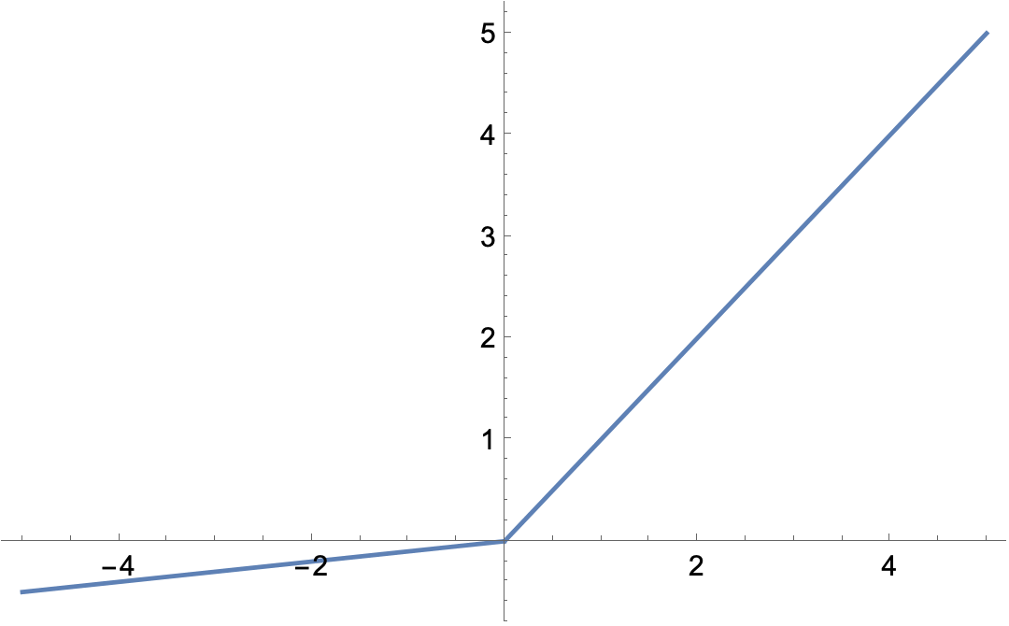
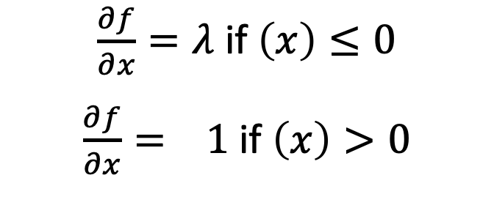
Gradient descent for ReLU
(Leaky) ReLU is non-differentiable when a parameter = 0
All tangent lines at this point are sub-derivatives
$\frac{∂f}{∂x}=λ$ if $\left(x\right)≤0$
$\frac{∂f}{∂x}= 1$ if $\left(x\right)>0$

Slide 8
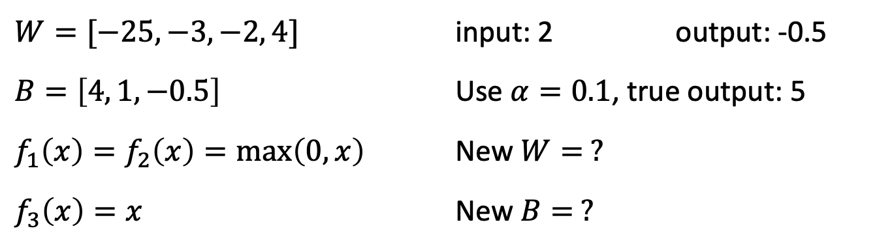
Update our simple ANN (input: 2)
$${ f}_{1}({x′}^{1}+b_{1})$$
$$w_{1}x_{i}={x′}^{1}$$
$$w_{3}f_{1}(∙)={x′}^{3}$$
$$x_{1…n}$$
$$f_{3}({x^{′}}^{3}+{x^{′}}^{4}+b_{3})$$
$$w_{2}x_{i}={x′}^{2}$$
$${ f}_{2}({x′}^{2}+b_{2})$$
$$w_{4}f_{2}(∙)={x′}^{4}$$
$W=[−25, −3, −2, 4]$ input: 2 output: -0.5
$B=\left[4, 1, −0.5\right]$ Use $α=0.1$, true output: 5
$f_{1}\left(x\right)=f_{2}\left(x\right)=\max\left(0,x\right)$ New $W= ?$
$f_{3}\left(x\right)=x$ New $B= ?$

Slide 9
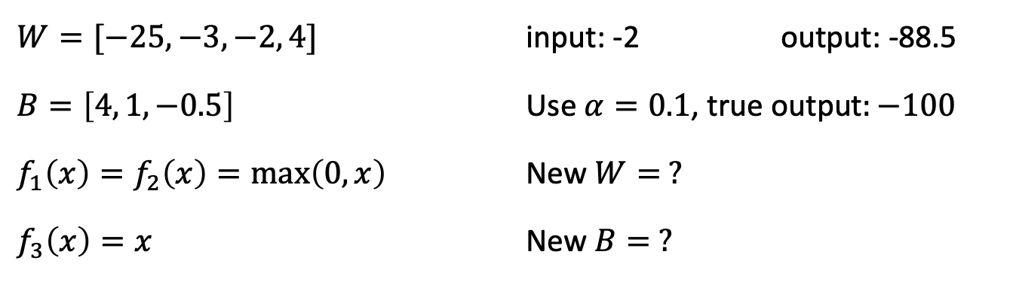
Our simple ANN (input: -2)
$${ f}_{1}({x′}^{1}+b_{1})$$
$$w_{1}x_{i}={x′}^{1}$$
$$w_{3}f_{1}(∙)={x′}^{3}$$
$$x_{1…n}$$
$$f_{3}({x^{′}}^{3}+{x^{′}}^{4}+b_{3})$$
$$w_{2}x_{i}={x′}^{2}$$
$${ f}_{2}({x′}^{2}+b_{2})$$
$$w_{4}f_{2}(∙)={x′}^{4}$$
$W=[−25, −3, −2, 4]$ input: -2 output: -88.5
$B=\left[4, 1, −0.5\right]$ $\text{Use} α=0.1\text{, }\text{true} \text{output}:−1006$
$f_{1}\left(x\right)=f_{2}\left(x\right)=\max\left(0,x\right)$ New $W= ?5$
$f_{3}\left(x\right)=x$ New $B= ?20$

Slide 10
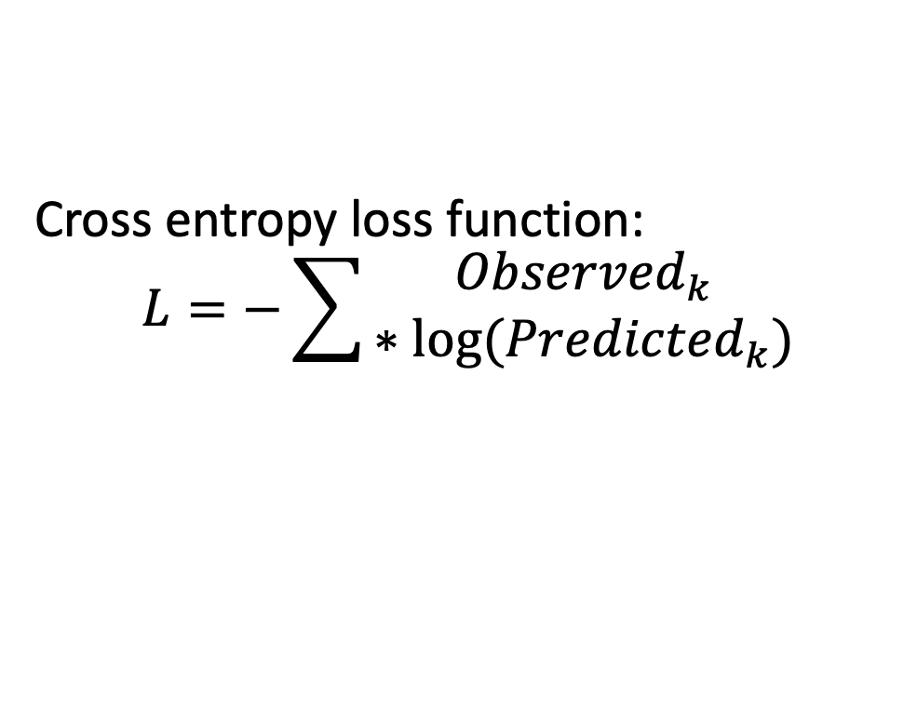
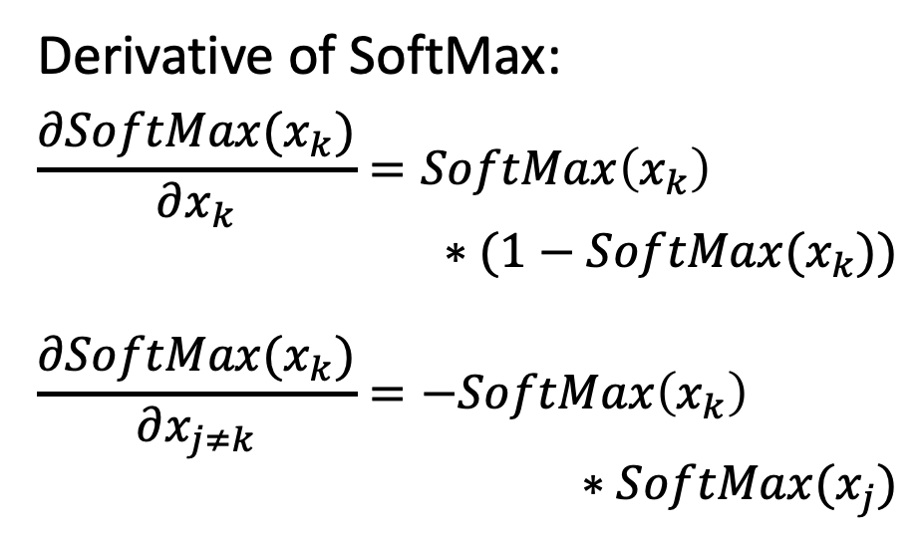
ANN classification
-1
Faculty
Derivative of SoftMax:
$$\frac{∂SoftMax(x_{k})}{∂x_{k}}=SoftMax\left(x_{k}\right)$$
$$∗(1−SoftMax(x_{k}))$$
$$\frac{∂SoftMax(x_{k})}{∂x_{j≠k}}=−SoftMax\left(x_{k}\right)$$
$$∗SoftMax(x_{j})$$
Graduate student
2.5
0
Undergraduate student
Output layer
SoftMax vector:
[0.027, 0.899, 0.074]
Cross entropy loss function:
$$L=−\sum{\begin{aligned}{Observed}_{k} \\ ∗log⁡({Predicted}_{k})\end{aligned}}$$

Slide 11
Homework
HW2 due Tuesday (Sept 20) at midnight
Programming Assignment 1 due Oct 12

